Slide 1
AI VIRTUAL MOTION CONTROLLER

Slide 2
The Virtual AI MOTION CONTROLLER provides an infrastructure between the user and the system using only a camera. It allows users to interface with machines without the use of mechanical or physical devices, and even control mouse functionalities.
INTRODUCTION:

Slide 3
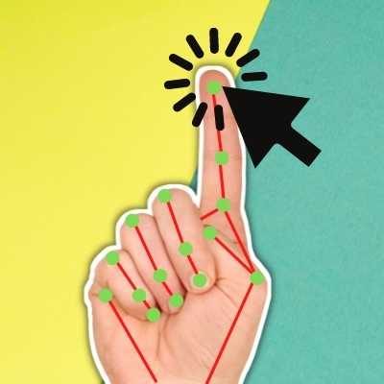

Slide 4
The main objective of the proposed virtual AI mouse is to furnish an alternative to the conventional physical mouse that provides mouse functions with the help of computer vision enabled computer that houses a web camera which recognizes fingers and hand gestures and processes the captured frames and uses a machine learning algorithm to execute the defined mouse functions like moving the cursor, right click, left click and scrolling function. Also we are using multiple libraries to perform this project.
PURPOSE :

Slide 5
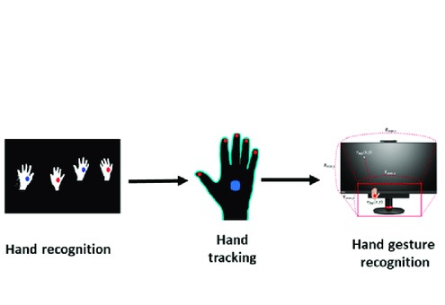
METHOD

Slide 6
media pipe
The MediaPipe framework is used by the developer for building and analyzing the systems through graphs, and it also been used for developing the systems for the application purpose. MediaPipe library is used by developers for architecting and analyzing various models through graphs and many of these have been used for building applications. MediaPipe Hands utilizes an ML pipeline consisting of multiple models working together. The model that incorporated MediaPipe needs to
work in a pipeline fashion. It consists of mainly graphs, nodes, streams and calculators. The MediaPipe framework is based on three fundamental parts; they are performance evaluation, framework for retrieving sensor data, and a collection of components which are called calculators , and they are reusable.
A pipeline is a graph which consists of components called calculators, where each calculator is connected by streams in which the packets of data flow through. The pipeline is implemented as a Media Pipe graph that uses a hand landmark tracking sub graph from the hand landmark module, and renders using a dedicated hand rendered sub graph.
The hand landmark tracking sub graph internally uses a hand landmark sub graph from the same module and a palm detection sub graph from the palm detection module. The calculators and streams combined create a data-flow diagram; the graph is created with MediaPipe where each node is a calculator and the nodes are connected by streams.

Slide 7
OPEN CV
OpenCV (Open Source Computer Vision Library) is an open source computer vision and machine learning software library. The library has more than 2500 optimized algorithms, which includes a comprehensive set of both classic and state if applications that used computer vision. In this model, OpenCV library is utilized for image and video processing and for detecting and analyzing faces and objects. [11]The developing of hand gesture recognition using Python and of-the-art computer vision and machine learning algorithms. This library is written in the python language

Slide 8
PROBLEM DESCRIPTION
This AI virtual mouse can be made use of in places where using a physical mouse is not feasible such as moist or wet conditions, to aid people who can’t handle a device and where there isn’t ample space for using a mouse and to eliminate the need of mouse and cable altogether. In view of the pandemic, there arises a need to avoid high-contact surfaces, out of which the mouse is one. In order to eliminate the need to avoid contact, the system provides an intuitive way to interact with the computer system with the use of hand-gestures and finger tips to emulate mouse-like functions such as scrolling, clicking,
and pointing.

Slide 9
RESULTS
The proposed model of AI virtual mouse demonstrates the idea of computer vision technology and machine learning
capabilities.
For verifying and testing of the proposed AI virtual mouse system only a certain quantity of datasets are attainable. The hand
tracking, finger-tip detection and gestures recognition have been performed in various illuminated conditions and at
diversified distances from the camera. The results of the testing are given below. The test was performed 25 times by 4
persons resulting in 600 gestures with manual labeling, and this test has been made in different light conditions and at
different distances from the screen, and each person tested the AI virtual mouse system 10 times in normal light conditions, 5
times in faint light conditions, 5 times in close distance from the webcam, and 5 times in long distance from the webcam, and
the experimental results are tabulated in Table:

Slide 10
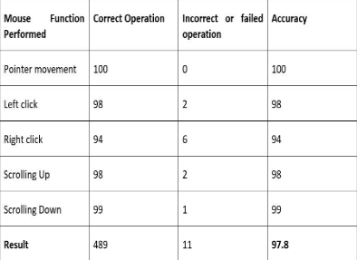

Slide 11
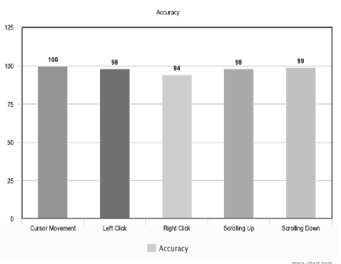

Slide 12
This AI virtual mouse has some drawbacks such as drop in accuracy of some functions like right click operation and inability to perform other mouse functions such as dragging and dropping, and selecting text. Another major limitation is that this model cannot function in the dark or low light settings. These drawbacks can be addressed in the future and can be overcome. Apart from the above-mentioned, additionally key board capability can be incorporated to emulate keyboard functions along with the mouse operations which proves to be the scope for the future..
FUTURE SCOPE

Slide 13
The main objective of the proposed virtual AI mouse is to furnish an alternative to the conventional physical mouse that provides mouse functions with the help of computer vision enabled computer that houses a web camera which recognizes fingers and hand gestures and processes the captured frames and uses a machine learning algorithm to execute the defined mouse functions like moving the cursor, right click, left click and scrolling function.
CONCLUSION

